Slide 1
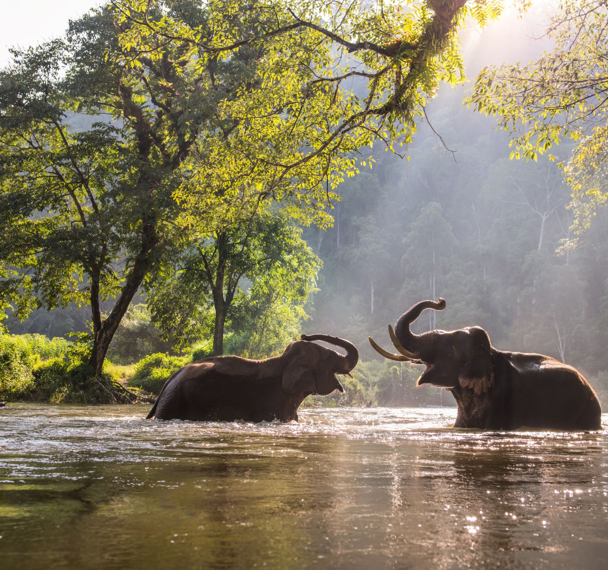
UML

Slide 2
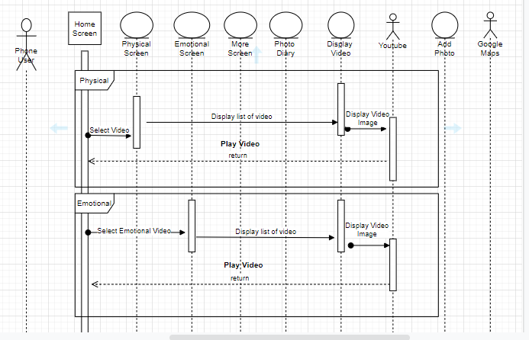
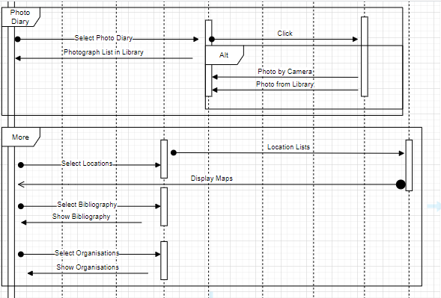
UML Sequence

Slide 3
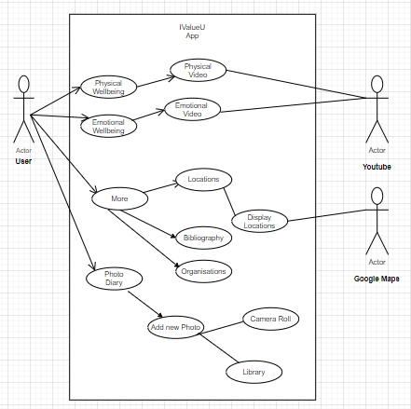
UML Case

Slide 4
UML Case description
Use Case ID: | 1
Use Case Name: | Physical Wellbeing
Actor: | User
Description: | Allows user to watch videos of physical wellbeing
Pre-Condition: | Physical Wellbeing
Post Condition: | Physical Wellbeing Video
Basic Flow: | N/A
Exceptional Flow: | N/A
Alternative Flow: | N/A

Slide 5
Use Case ID: | 2
Use Case Name: | Emotional Wellbeing
Actor: | User
Description: | Allows user to watch videos of Emotional wellbeing
Pre-Condition: | Emotional Wellbeing
Post Condition: | Emotional Wellbeing Video
Basic Flow: | N/A
Exceptional Flow: | N/A
Alternative Flow: | N/A

Slide 6
Use Case ID: | 3
Use Case Name: | More
Actor: | User
Description: | Allows user to be displayed the locations from google maps, bibliography and organisations
Pre-Condition: | More Screen
Post Condition: | Locations, Bibliography and Organisations
Basic Flow: | N/A
Exceptional Flow: | N/A
Alternative Flow: | N/A

Slide 7
Use Case ID: | 4
Use Case Name: | Photo Diary
Actor: | User
Description: | Allows user to access the photo library and camera roll
Pre-Condition: | N/A
Post Condition: | N/A
Basic Flow: | N/A
Exceptional Flow: | N/A
Alternative Flow: | N/A

Slide 8
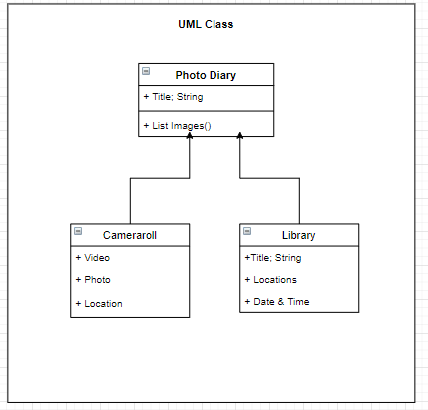
UML class

